Slide 1
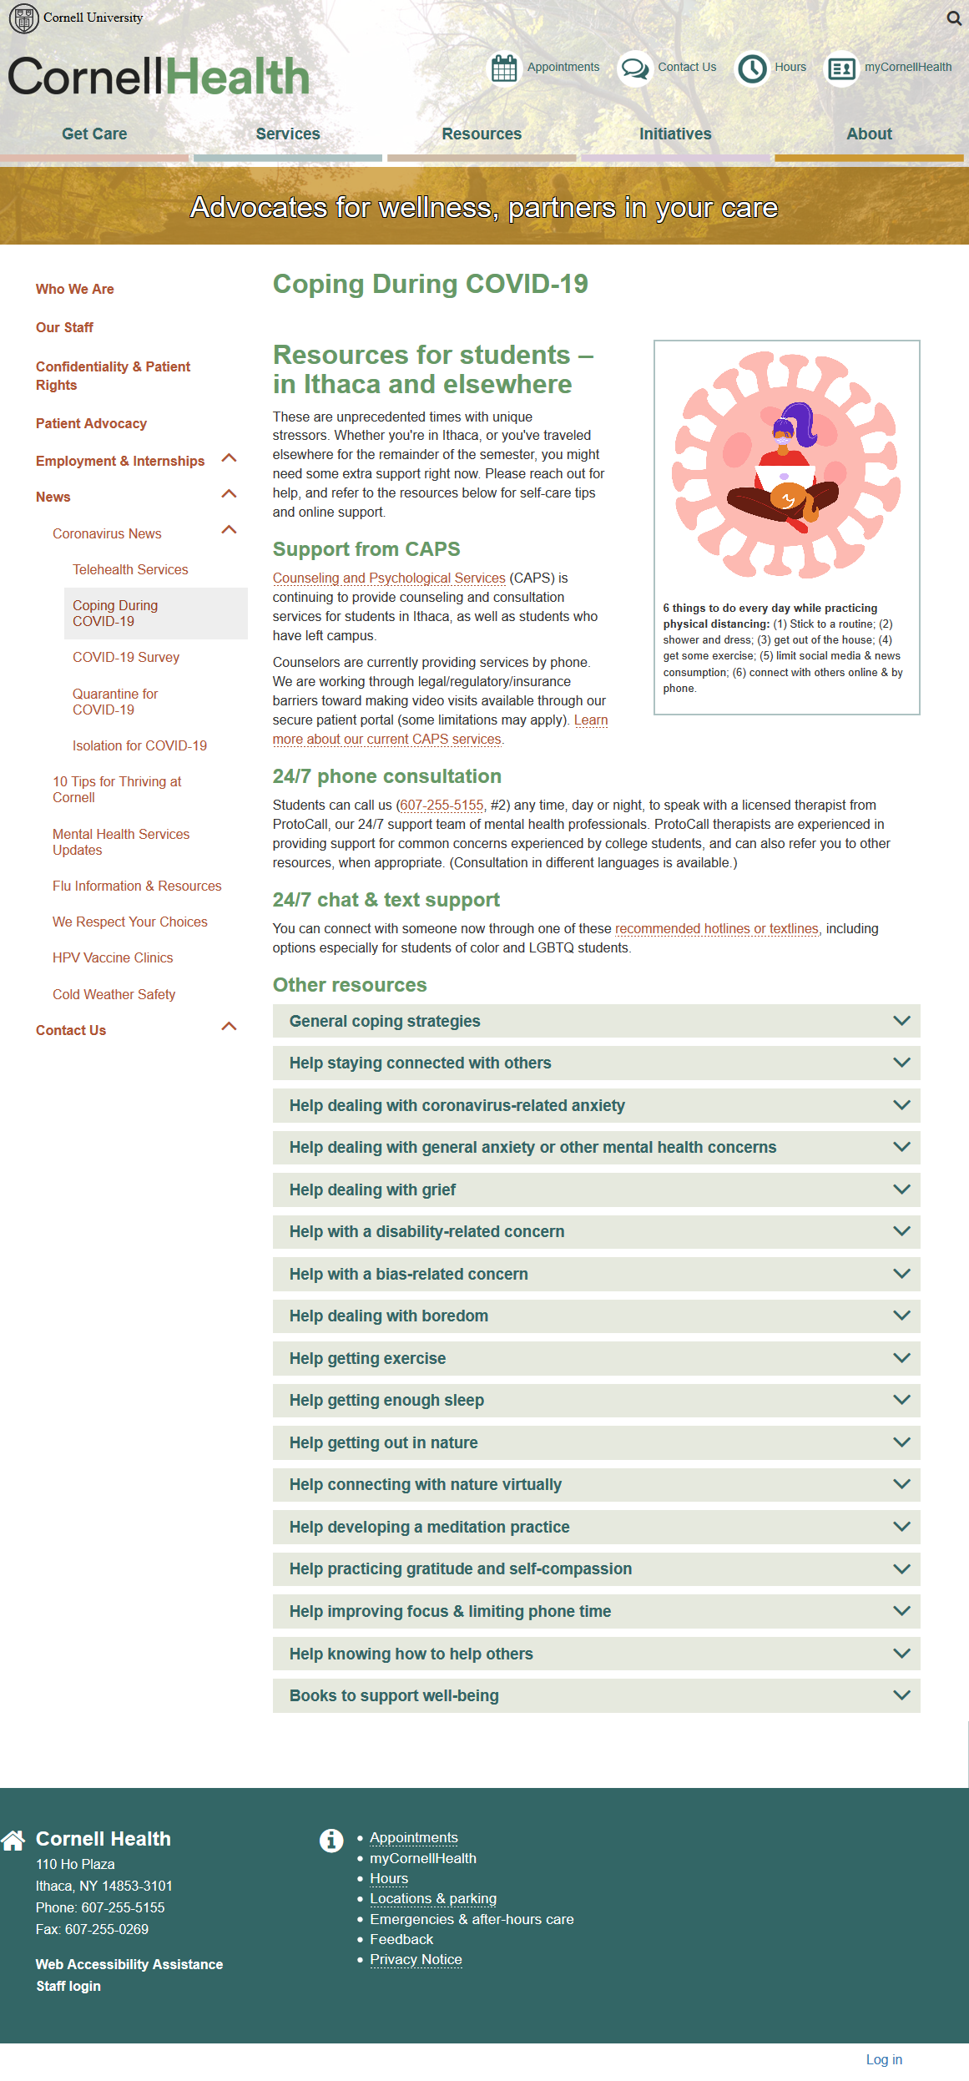
Resource for your Canvas site https://health.cornell.edu/about/news/2019-novel-coronavirus/coping-during-covid-19
Notes:
Catherine

Slide 2
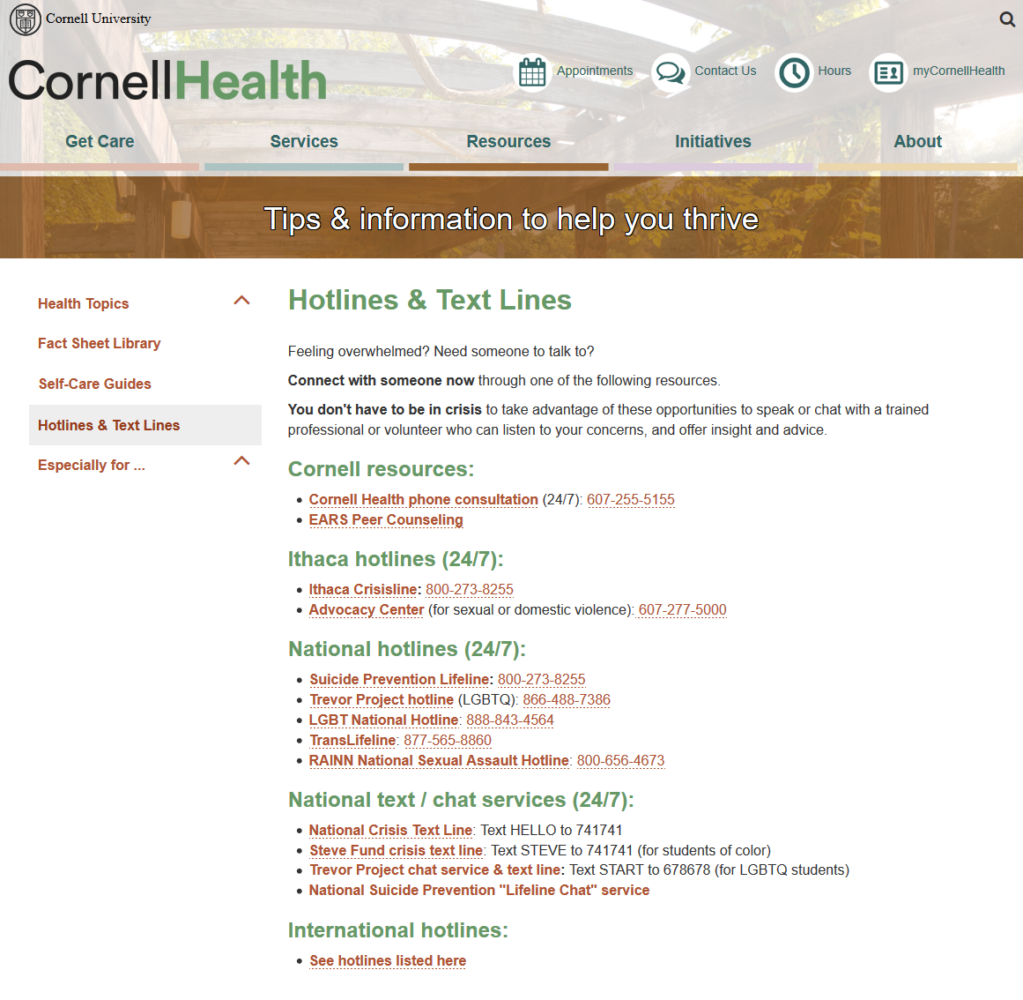
Resource for your Canvas site
Source: https://health.cornell.edu/resources/hotlines-text-lines
Notes:
Catherine

Slide 3
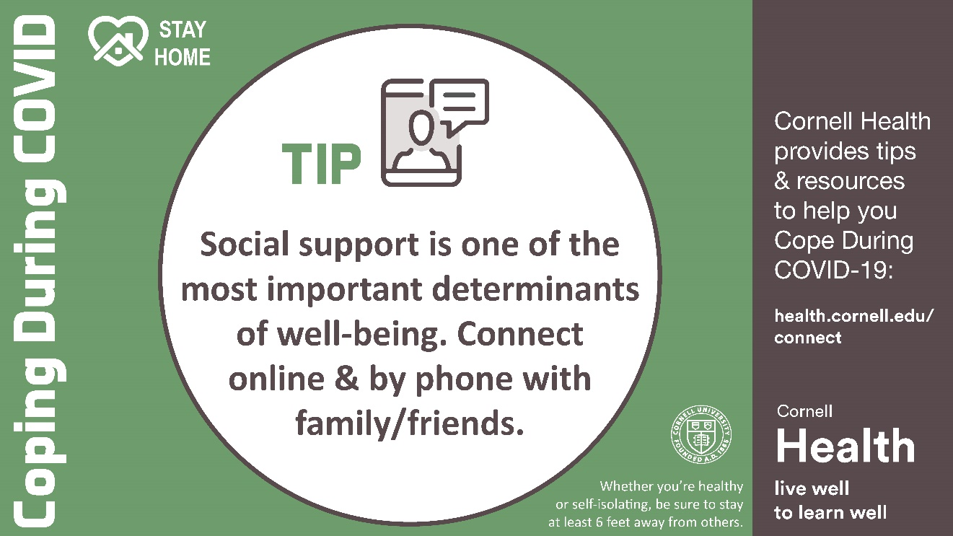
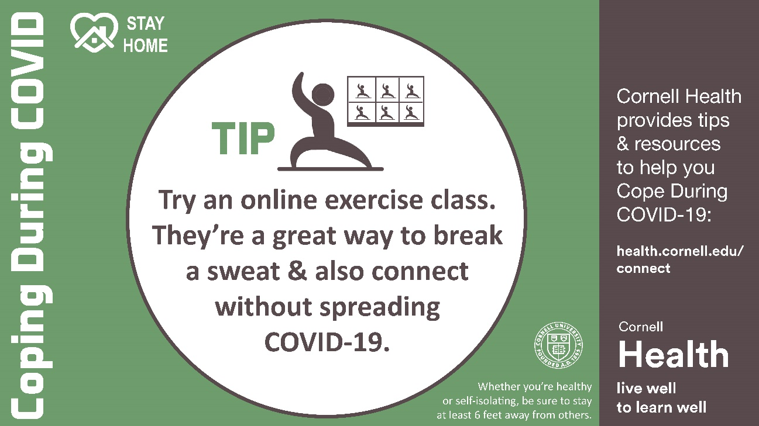
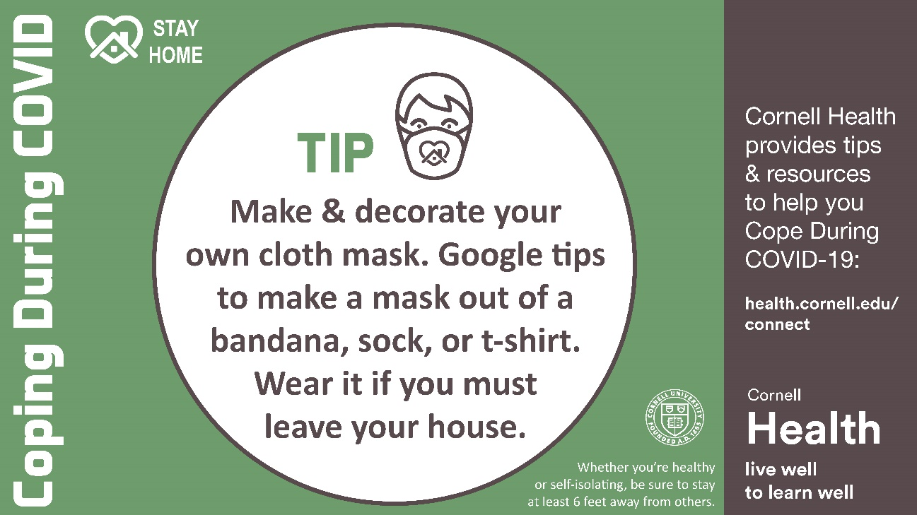
Resources for your Canvas site
https://health.cornell.edu/about/news/2019-novel-coronavirus/covid-19-media-slides
Notes:
Cath: more for your Canvas course site or the beginning or end of ppt slides you give to your students to read through.

