Slide 1
AVP of Social Sciences Office of the Vice President for Research and Innovation
Cornell’s Academic Centers: An Overview of Resources and Programs
February 17, 2022

Slide 2
Office of the Vice President for Research and Innovation
Research: funding, infrastructure, facilities, compliance, support
(OSP, IRB, facilities, etc.)
Innovation: licensing, start-ups, technology transfer, social good,
entrepreneurship
Ongoing programs:
REFRESH, Re-energizing Faculty Research Engagement and Success (with OFDD, COE, CHE, CALS, CIS, CAS, ILR, CVM, and CCB)
Support for PI Research while Postdocs and Research Associates are on Parental Leave (with BPP, COE, CHE, CALS, CAS, CVM)

Slide 3
Associate Vice Provost for Social Sciences
Concierge and Fixer in Social Science related disciplines
Close partnership with CCSS, OFDD, Departments, etc.
Please reach out with questions, comments, and suggestions: maria.d.fitzpatrick@cornell.edu

Slide 4
David M. Lodge Francis J. DiSalvo Director Cornell Atkinson Center for Sustainability

Slide 5
Cornell Atkinson Center for Sustainability
Unexpected connections
Faculty Fellows
Topical Lunches
Transformative research
Interdisciplinary collaboration
Holistic thinking
Influencing policies, practices, products, and opinions
Climate
Energy
Food
One Health

Slide 6
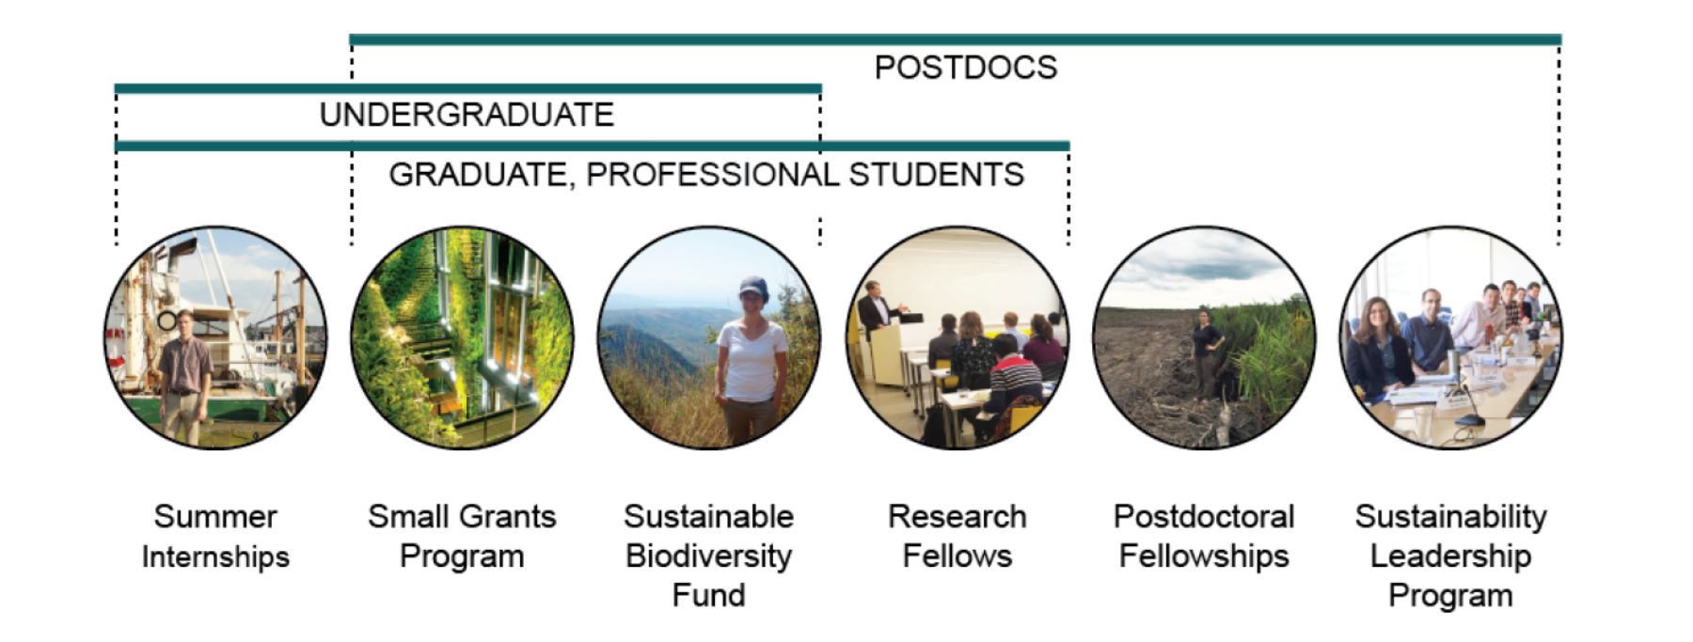
FACULTY
Academic Venture Fund
Innovation for Impact Fund
Rapid Response Fund
Funding Programs

Slide 7
Bridging scientific research and community practice
Resources for Faculty & Research
Evalyn Edwards Milman BCTR Faculty Fellow Fund
T/TT faculty; 2 years of support at $15k and GRA per year
Research focused on needs of young children; help expand Center’s reach
Seed funding to support research aligned with the BCTR mission
T/TT faculty; 2 years of support at $15k and GRA per year
Research focused on needs of young children; help expand Center’s reach
Help launch and incubate translational research programs
PRYDE: Program for Research on Youth Development & Engagement
ARC: Action Research Collaborative
CNI: Community Neuroscience Initiative

Slide 8
We support translational research projects that aim to enhance human development, health and well-being
Student Opportunities
Several graduate research assistantships (GRAs) provided each year.
Most support cross-cutting Center work; some specific project support
Increasing levels of undergraduate student support.
Emerging hub for community engaged learning (CEL)
Several projects offer semester or summer stipends to support
BCTR is also home to capstone courses in translational and (CEL).
Learning Opportunities
Talks at Twelve
Research-Practice Partnership Series
Translational Research Summer Institute
How-To Seminars
CornellBCTR
https://bctr.cornell.edu

Slide 9
February 2022 | Information Session

Slide 10
The Center's Vision
To achieve health equity in local, national, and global communities through partnerships for cross-campus collaborative research, education, service, and advocacy.

Slide 11
The Center's Mission
The fivefold mission of the Cornell Center for Health Equity is to advance health equity by:
1
2
3
4
5
Training outstanding investigators, with an emphasis on people from underrepresented groups.
Educating students, trainees, faculty, and communities.
Engaging with diverse communities in this work.
Applying knowledge to maximize its impact on practice and policy.
Generating and sharing new knowledge

Slide 12
Center Resources and Activities
Monthly CCHEq Health Equity Seminar Series This forum shares details on health equity and social justice work-in-progress. Occurs every first Friday of the month from 12:30 - 1:30 pm EST.
Annual Symposia An important goal of the annual symposia is to facilitate cross-campus and community collaborations.
CCHEq Student Engagement Opportunities The CCHEq Undergraduate Student Chapter offers opportunities to engage with students who share the goal of advancing health equity.

Slide 13
Center Resources and Activities
Rapid-Response Collaborative Conversations Brainstorming sessions are hosted to share knowledge and generate ideas in response to federal and foundation grant requests for proposals.
CCSS Grant Writing Development Program In partnership with the Cornell Center for Social Sciences (CCSS) and Cornell Population Center (CPC), this program focuses on mentoring social science faculty through the process of writing an NIH grant from concept to submission. Announcements are issued at the start of the calendar year.

Slide 14
Center Resources and Activities
Pilot Research Project Grants This program aims to generate pilot data for eventual extra-mural funding and encourage cross-campus collaboration. We fund up to 4 one-year pilot projects during each grant cycle in the amount of $50,000. Announcements are issued at the start of the calendar year.
Community Partnership Building Grants This program aims to establish or strengthen collaborative partnerships that enable meaningful involvement of community stakeholders in health equity research. We fund 4 one-year community projects in each grant cycle in the amount of $5,000. Announcements are issued at the start of the academic year.

Slide 15
JOIN US!
To join, visit our application: https://centerforhealthequity.cornell.edu/home/membership-application/

Slide 16
Peter K. Enns
Cornell’s Academic Centers:
An Overview of Resources and Programs
(Office of Faculty Development and Diversity)
Robert S. Harrison Director, CCSS
Professor, Dept. of Government & Brooks School of Public Policy
Co-founder and Chief Data Scientist, Verasight

Slide 17
PhD Data Science Fellows
Faculty Fellows
Select Programs and Services
Qualitative and Interpretive Research Institute (QuIRI)
Training and grant support for faculty and students
Faculty Research Grants (twice a year)
Up to $30K
Grant Writing Program (with CPC and CCHEq)
Advanced Computing Resources
Workshops/Trainings/Consultations
Secure Data Services (FSRDC and CRADC)
Become an Affiliate: https://socialsciences.cornell.edu/

Slide 18
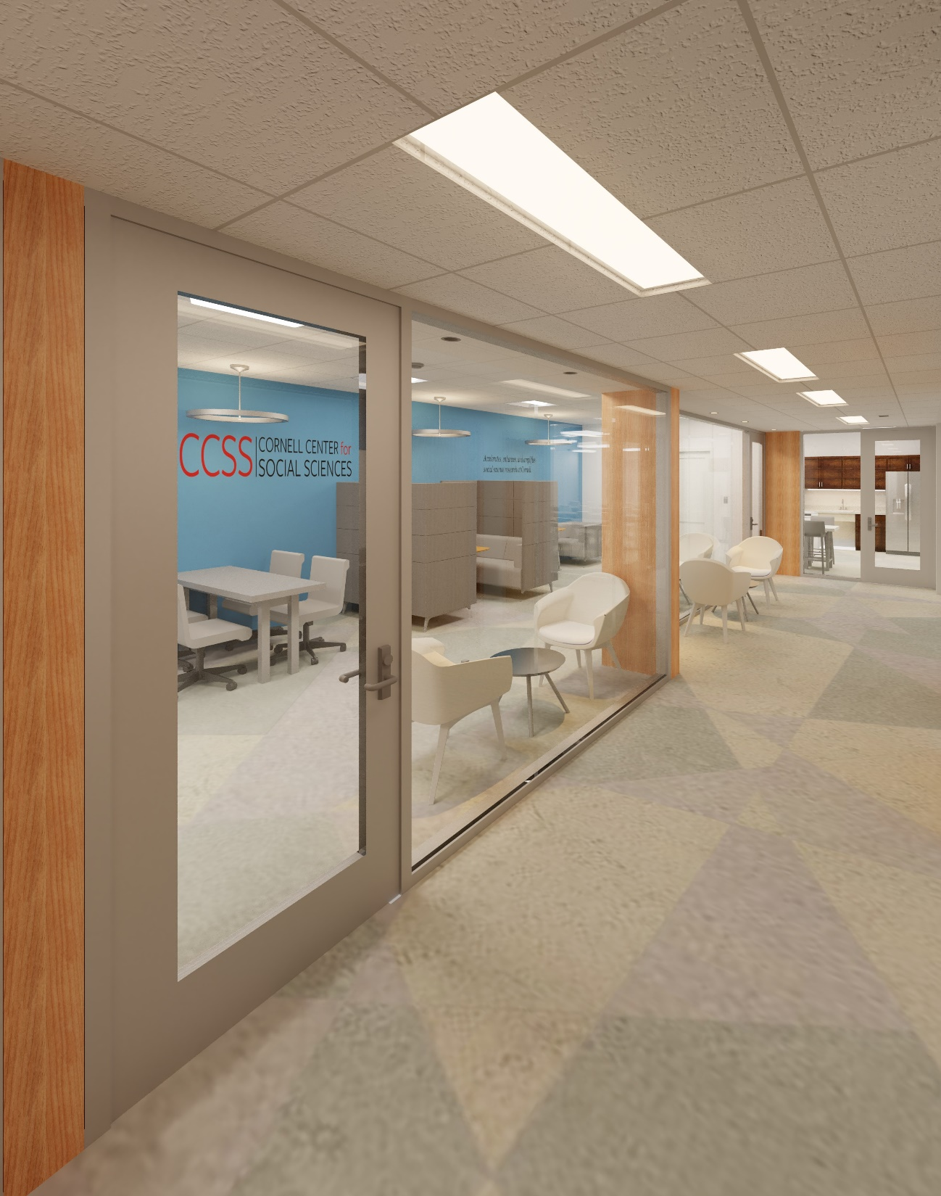
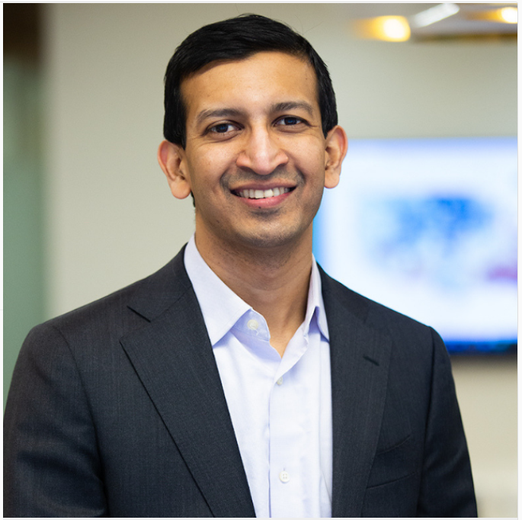
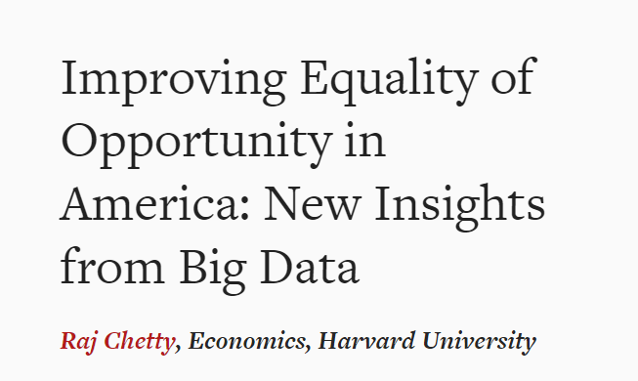
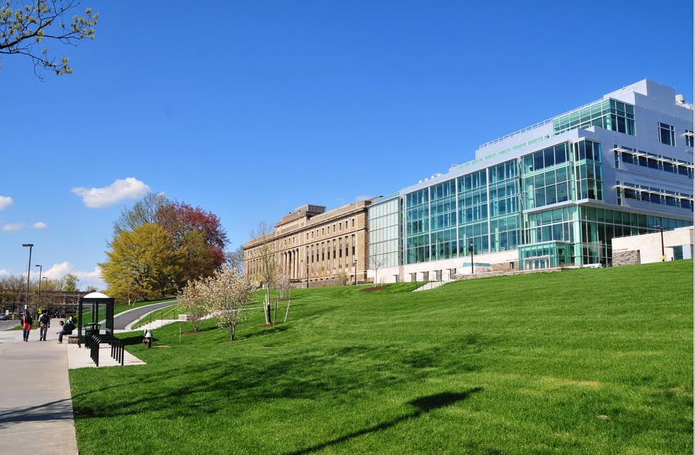
Save the Date: 4/18/22

Slide 19
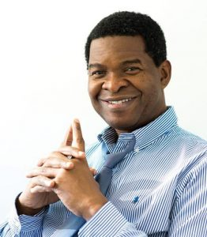
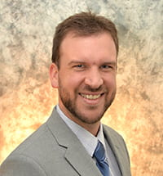
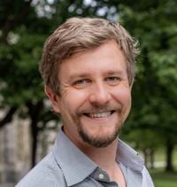
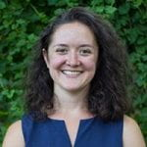
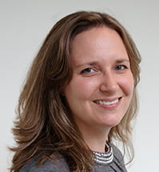
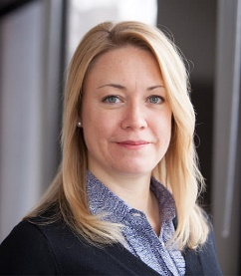
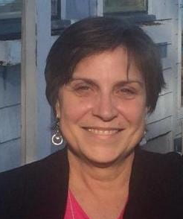
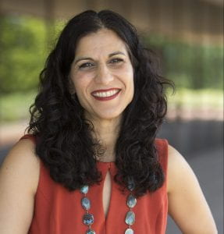
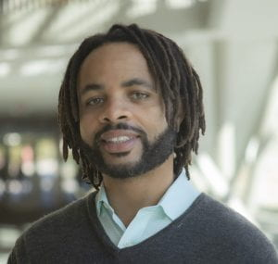
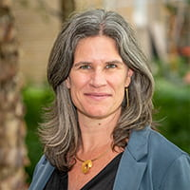
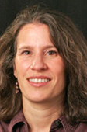
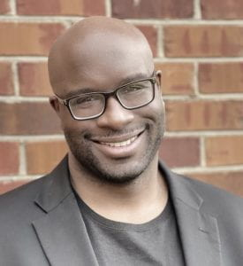
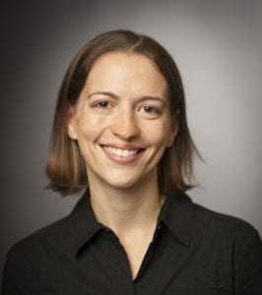
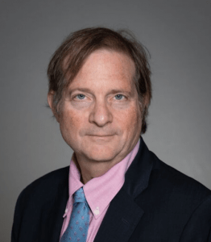
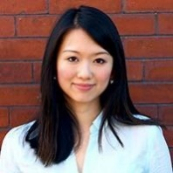
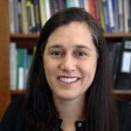
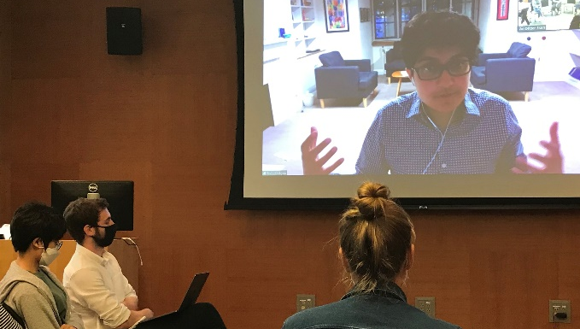
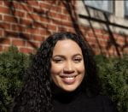
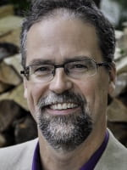
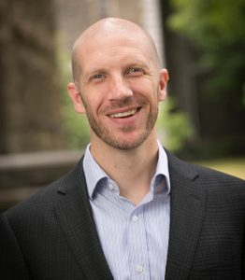
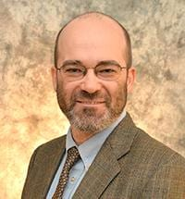
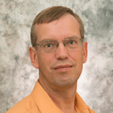
fostering collaboration & innovation in population science
Seminars & Conferences
Working Groups
Grant Development
Data Support
Demographic Training
Post Doc Program
Policy Engagement
National Network
www.cpc.cornell.edu

Slide 20
CPIP Programs and Activities
CIPA offers the Science, Technology & Infrastructure Policy (STIP) concentrations as part of the MPA degree. CPIP offers no degrees.
CIPA manages the Infrastructure Project Management & Finance (IPMF) Fellows program with financial support from CPIP.
CIPA manages the Cornell Broadband Network, on behalf of CPIP.
CIPA hosts a Zoom Breakfast Series of infrastructure leaders, mostly sourced from the CPIP Board of Advisors, which is open to the entire Cornell community.
CPIP hosts an Executive-in-Residence, who offers mentoring to CIPA students.

Slide 21
CPIP Core Assets
CPIP maintains a 40-member Advisory Board of infrastructure industry executives. CIPA maintains a position on the board
CPIP identifies and cultivates summer internships and full-time jobs with Board Member companies, often filled by CIPA students
CPIP is a member of the International Public Private Partnership Scholars Network (IP3SN), which provides access to global research and though leadership in infrastructure policy
CPIP offers webinars and conferences to help fulfill Cornell’s commitment to public engagement and outreach

Slide 22
CPIP Uses its Resources to Support Peer-Review Research
CPIP has hosted numerous senior sabbatical visitors from around the world
CPIP has supported several PhD students working in infrastructure policy
CPIP has supported several post-doctoral researchers
CPIP has supported numerous undergraduate and masters-student researchers in infrastructure policy

Slide 23
The Mario Einaudi Center for International Studies is Cornell’s hub for global thinking and action.
| 2022 global research priorities:
migrations
inequalities, identities and justice
democratic threats and resilience
einaudi.cornell.edu
** Global Hub Salon Series **
Celebrating 60 years of global impact
Notes:
Hub for international studies - Einaudi

Slide 24
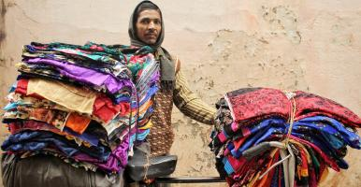
Einaudi’s Regional and Thematic Programs
Comparative Muslim Societies Program
East Asia Program
Institute for African Development
Institute for European Studies
Latin American and Caribbean Studies
Peace and Conflict Studies
South Asia Program
Southeast Asia Program

Slide 25
Office of Academic Integration
Gary Koretzky, MD, PhD gak36@cornell.edu

Slide 26
Overarching Goals
Create opportunities for faculty in Ithaca and New York City to collaborate to advance their scholarship
Integrate with Radical Collaboration initiatives
Support competitive, multi-investigator, cross-campus research programs and grow them into “centers of excellence”
Offer unique educational opportunities to our students
Notes:
Create opportunities for faculty on the Ithaca and New York City campuses to collaborate to advance their individual and collective scholarship and to provide opportunities for our students through unique educational offerings
Incentivize and support multi-investigator, cross campus research programs that can compete for extramural funding
Grow such programs into recognized “centers of excellence”

Slide 27
Intercampus Research Symposia
Engaging scientist in the social, physical, life, and information sciences around a topic or theme of interest
Broad disciplinary and topical diversity; Faculty leads from A&S, CALS, CVM, Engineering, Human Ecology & WCM
17 Intercampus Research Symposia supported
Outcomes: 5 extramural awards ($8.25M), 4 applications submitted, 5 publications
The Moral Psychology of Social Tech, June 2022, Cornell Tech John Doris - Arts & Sciences, Philosophy Rachana Kamtekar - Arts & Sciences, Philosophy Shaun Nichols - Arts & Sciences, Philosophy Helen Nissenbaum - Cornell Tech, Information Science

Slide 28
Multi-Investigator Seed Grants (MISG)
Support for projects from any discipline; aimed towards developing multi-investigator, extramurally funded grants
Lead PIs representing 7 colleges in Ithaca, and the WCM & Cornell Tech campuses
46 MISG project teams supported
$39M in external awards
2022 RFA posted! https://academicintegration.cornell.edu/multi-investigator-seed-grant-rfa

Slide 29
Getting The Gist: A “Big Picture” Approach To Improvements In End-of-life Decision-making And Care
Advancing The Health Of Refugees By Increasing Knowledge Of Legal Rights Through Digital Tools
An Integrated Research Program To Support Caregivers Of Older Adults With Dementia
Climate Change, Pollen And Asthma Attacks
The Interdependence Of Physical And Psychological Health During The Adolescent Reproductive Transition
Support Beyond Typical STEM Projects

